Slide 1


MindMend-A Mental health prediction app
User Manual
Author: Lavanyaa Kohli
Notes:
Preworks course home assignments

Slide 2
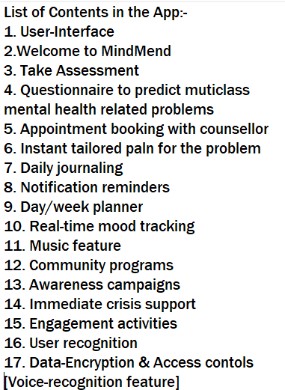
Table of Contents
Acknowledgements Contents in the App:-
My Introduction
Internship Journey
App Introduction
How to use the app
Demo Video
Toolkit Walkthrough
Contact Person

Slide 3
Acknowledgements
I would like to express my heartfelt gratitude to all those who have contributed to the success of my internship project.
Firstly, I am deeply thankful to my Mentor, [Ms. Sanjana] for her invaluable guidance, support, and encouragement throughout my internship. Her expertise , insights and constructive feedback have been instrumental in shaping my understanding of the project and enhancing my skills in the field.
I would also like to extend my appreciation to the entire team of [CLEVERED] for their collaboration and assistance. Working alongside such talented professionals has been a rewarding experience, and I have learned so much from their diverse perspectives and experiences.
Additionally, I would like to acknowledge all my FELLOW BATCHMATES who have offered their time and knowledge, helping me overcome challenges and inspiring me to push my limits.
Finally, I want to express my gratitude to Family & Friends for their unwavering support and encouragement during my internship journey. Their belief in my abilities has motivated me to strive for excellence.
This internship has not only enriched my professional development but has also provided me with lifelong memories and connections. Thank you all for being a part of this remarkable journey.

Slide 4
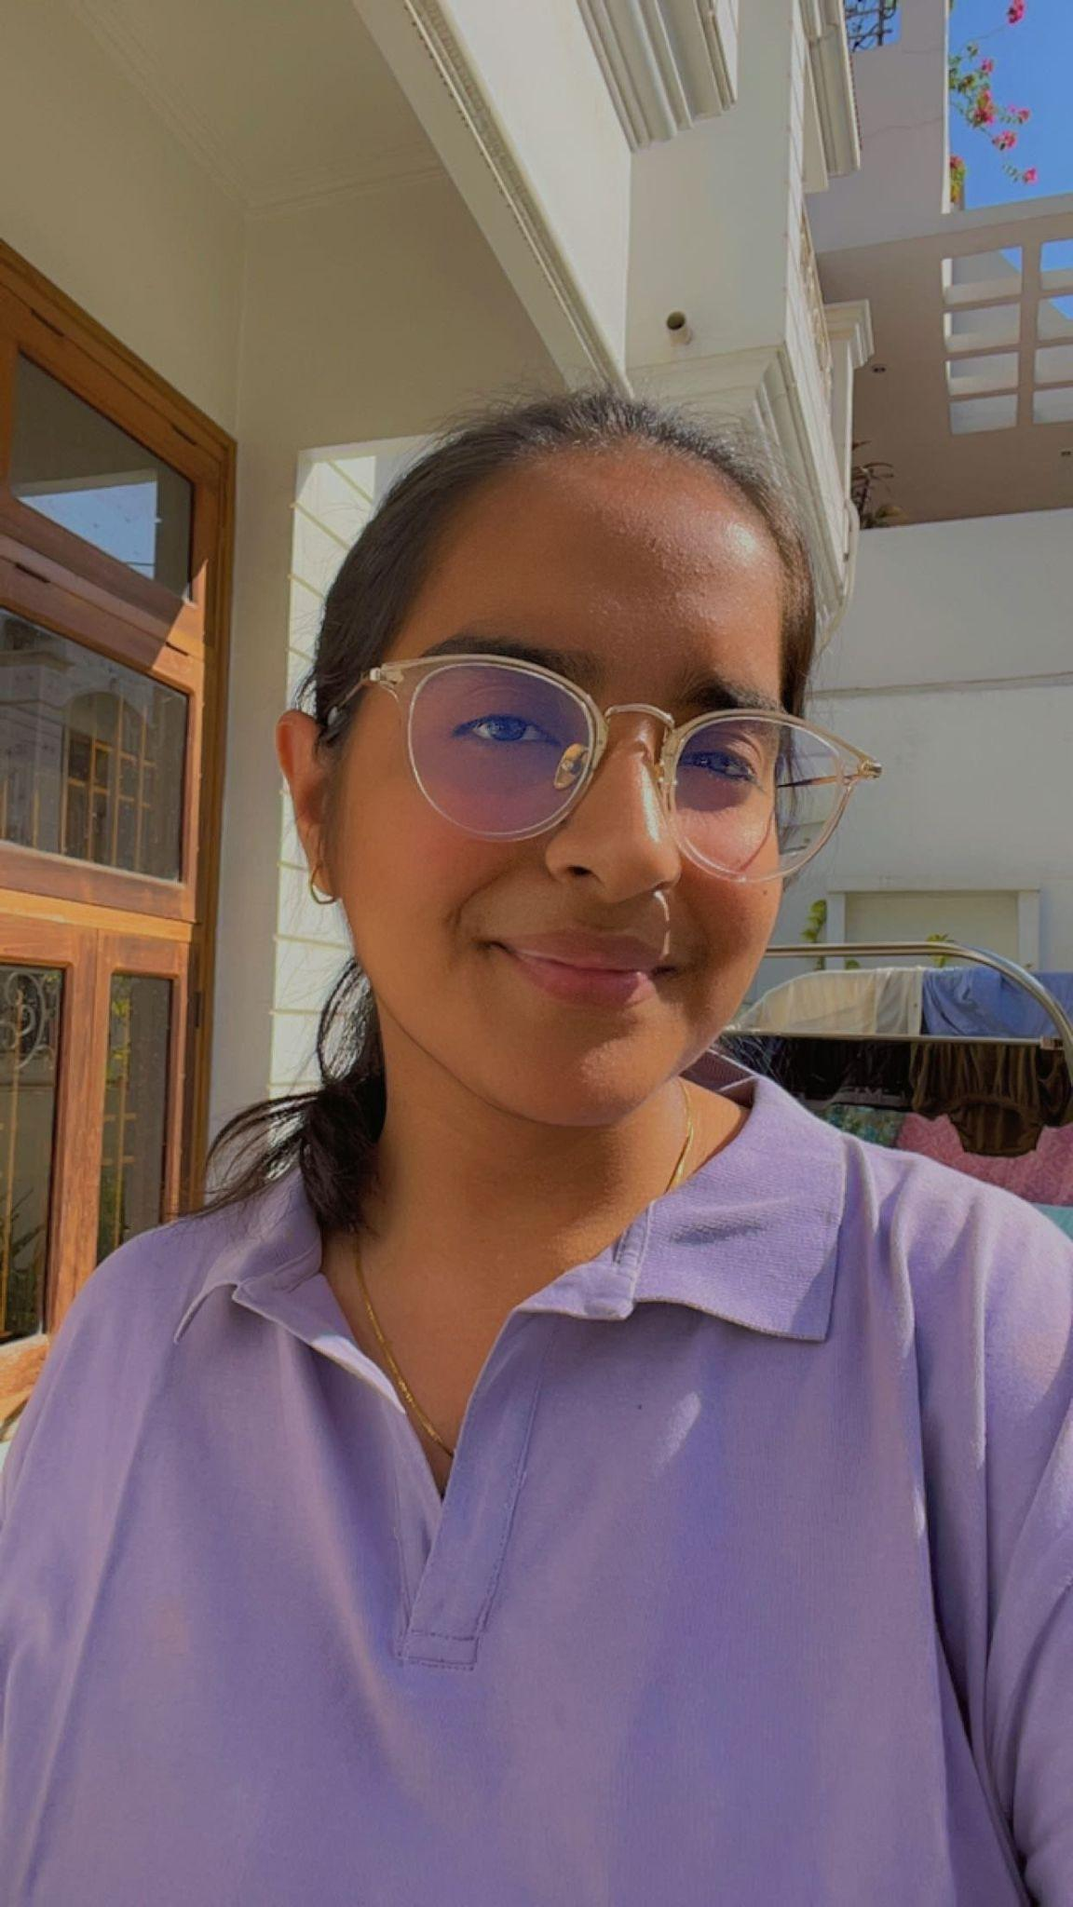
About Me..
Name- Lavanyaa Kohli
Age- 17 yrs
Grade- Class 12th session ‘24
I aspire to be a Commercial Pilot in future.

Slide 5
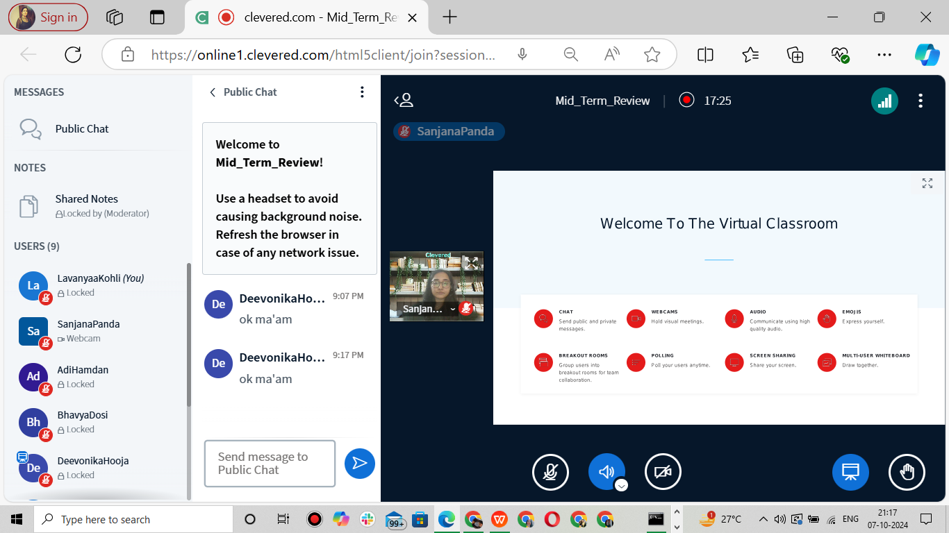
About My Internship Journey with Clevered..
Your Internship Experience with Clevered:-
It was a prestigious opportunity that offered informative learning, practical experience, and valuable networking in a high-caliber academic environment. It was both challenging and rewarding and i am really grateful for getting to experience this.

Slide 6
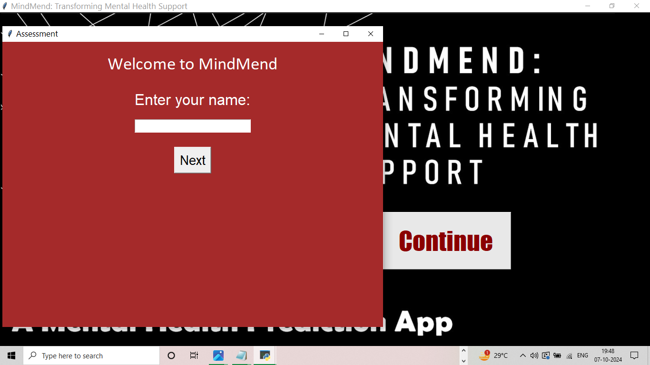
About App..
App’s Main Menu
App’s Introduction-
MindMend is an innovative platform designed to offer accessible, personalized, and compassionate mental health support. Our mission is to break the barriers surrounding mental well-being by providing users with tailored tools to assess, track, and improve their mental health in a safe and non-judgmental environment.

Slide 7
How to use the App?

Slide 8
User-Interface
Screenshot/ Pic of each option/screen of the App
Steps to use the same
Click on CONTINUE

Slide 9
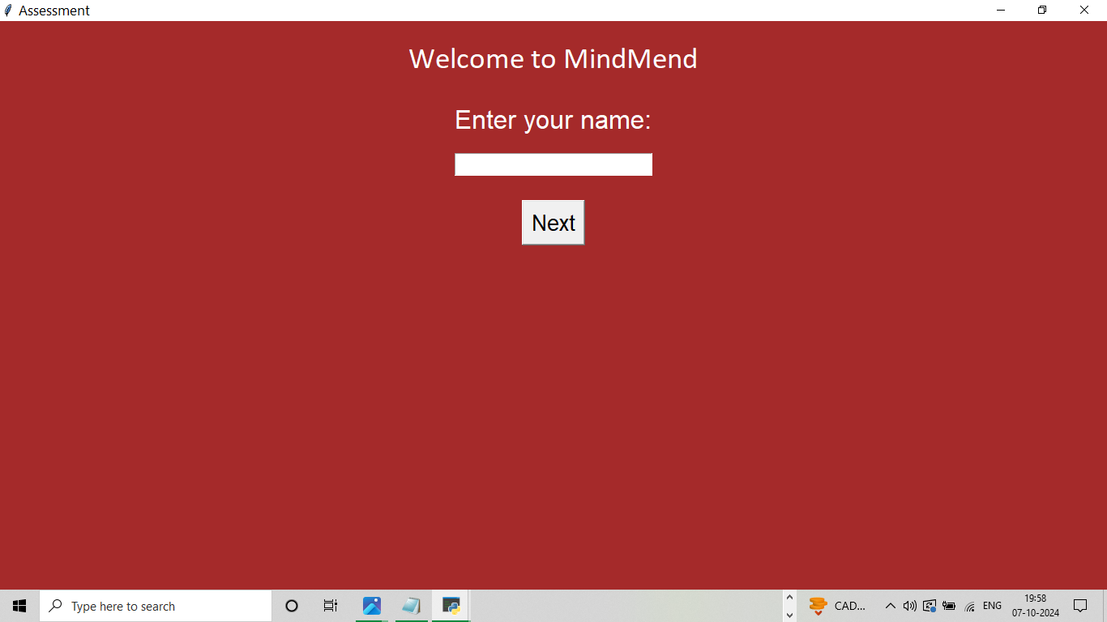
Option Name(This will be repeated for each option of the App)
Screenshot/ Pic of each option/screen of the App
Enter your NAME
Then click on NEXT

Slide 10
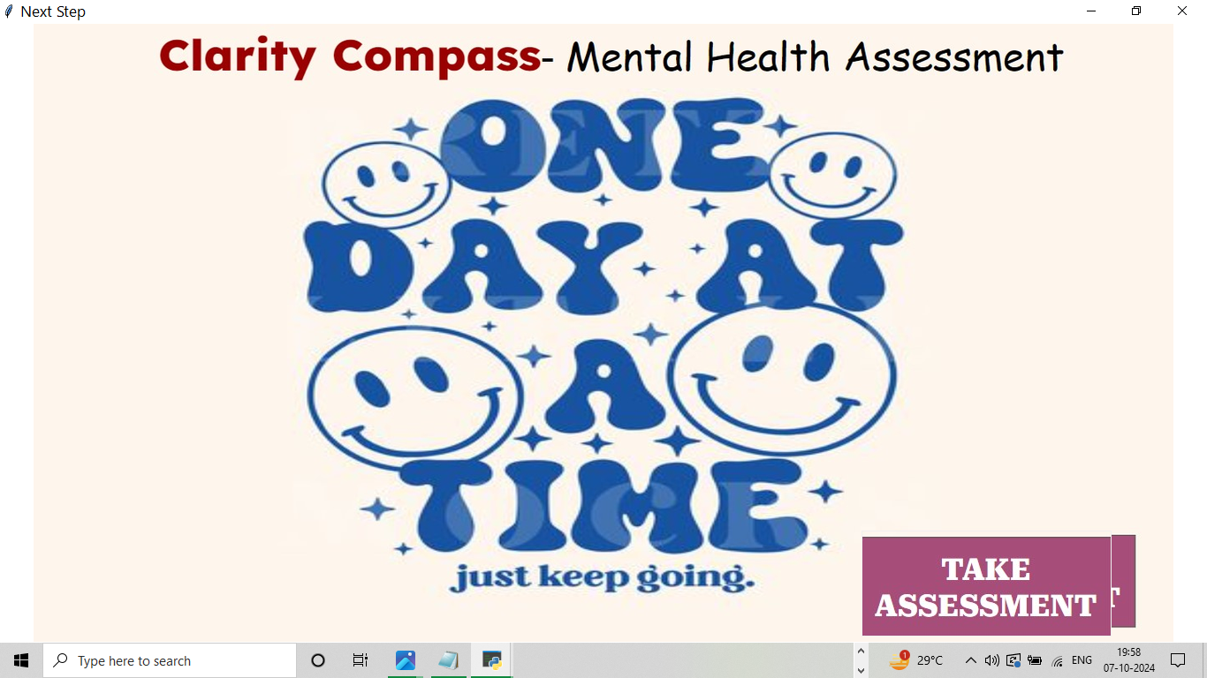
Option Name(This will be repeated for each option of the App)
Screenshot/ Pic of each option/screen of the App
Click on
TAKE ASSESSMENT

Slide 11
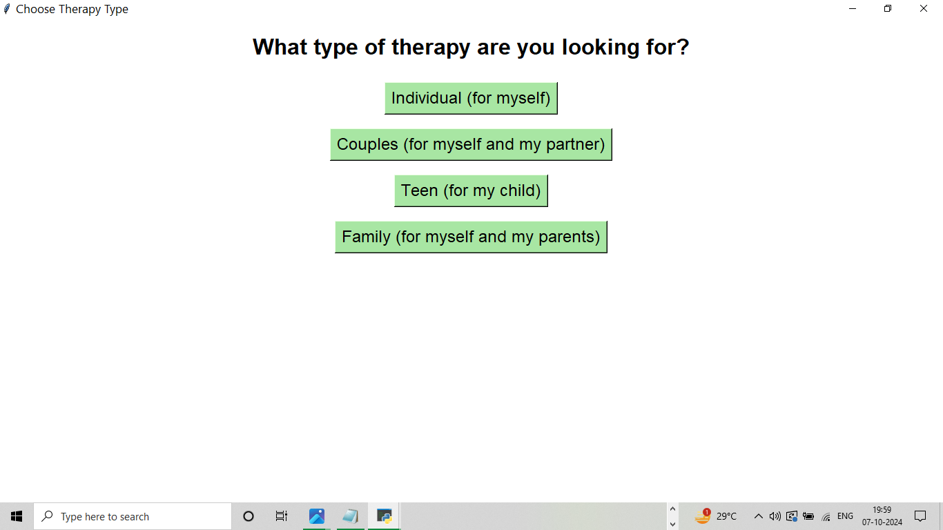
Option Name(This will be repeated for each option of the App)
Screenshot/ Pic of each option/screen of the App
Choose the type of therapy you are looking for by clicking on any one of the options given in GREEN

Slide 12
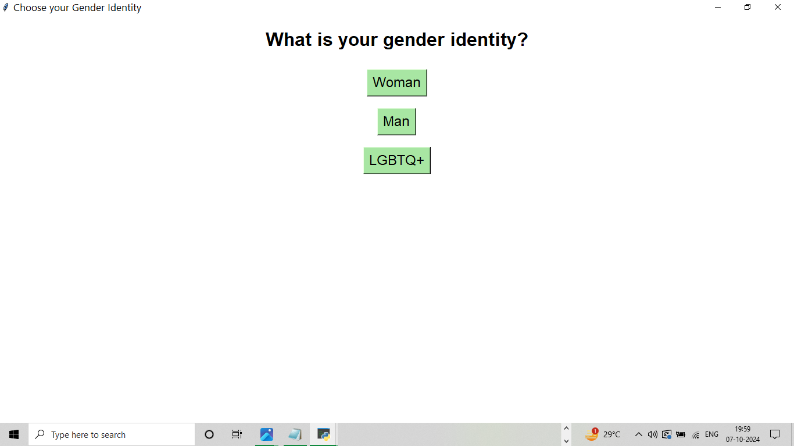
Option Name(This will be repeated for each option of the App)
Screenshot/ Pic of each option/screen of the App
Specify your Gender by clicking on any one option given below in GREEN

Slide 13
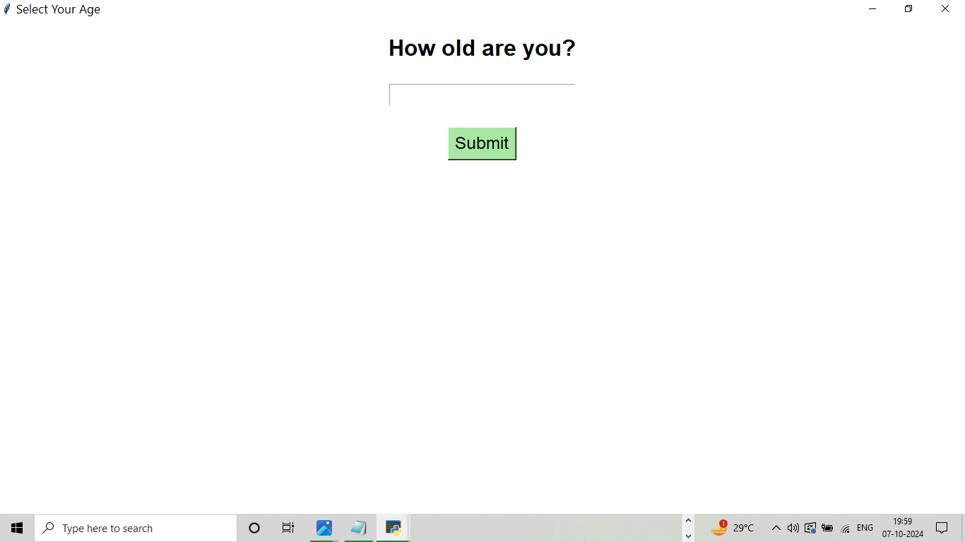
Option Name(This will be repeated for each option of the App)
Screenshot/ Pic of each option/screen of the App
Enter your age and click on SUBMIT

Slide 14
Demo Video
Demo any 2 features/ functions/ options of your project. Make a recording of the same and attach here as a backup if needed
DEMO VIDEO

Slide 15
Toolkit Walkthrough
Conduct 1 minute quick walkthrough of App Development Toolkit Workbook and LinkedIn and Github launch of the App. Attach links here for quick access.
AI WORKBOOK WALKTHROUGH
Github Launch
Linkedin Launch

Slide 16
Contact Person
Please reach out to Lavanyaa at lavanyaakohli2k20131968@gmail.com
for any questions/ concerns/ suggestions on the App

Slide 17
Thank you!

